Slide 1



ERD
Sistem Basis Data
Rizka Wakhidatus Sholikah

Slide 2



Outline
What is ERD?
Type of notation in ERD
Component of ERD
Create ERD
www.its.ac.id
INSTITUT TEKNOLOGI SEPULUH NOPEMBER, Surabaya - Indonesia

Slide 3

ERD
ERD (Entity Relationship Diagram)
Representing the view of the database as seen by end-user
Can be used to understand and design the data requirements of organization
Independent from database type
www.its.ac.id
INSTITUT TEKNOLOGI SEPULUH NOPEMBER, Surabaya - Indonesia

Slide 4
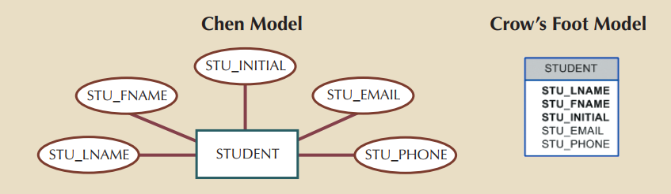
Type of notation used in ERD
www.its.ac.id
INSTITUT TEKNOLOGI SEPULUH NOPEMBER, Surabaya - Indonesia

Slide 5
Main component of ERD
Entities
Attributes
Relationships
www.its.ac.id
INSTITUT TEKNOLOGI SEPULUH NOPEMBER, Surabaya - Indonesia

Slide 6
Entity
Represent a real world object
Person
Class
Course
In a database entity is representing as a table
An entity is represented by a rectangle that contain the entity’s name
The entity name → a noun → usually written in a capital letters
www.its.ac.id
INSTITUT TEKNOLOGI SEPULUH NOPEMBER, Surabaya - Indonesia

Slide 7
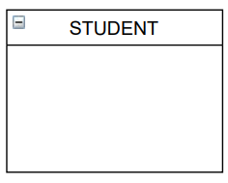
Entity cont.
www.its.ac.id
INSTITUT TEKNOLOGI SEPULUH NOPEMBER, Surabaya - Indonesia

Slide 8
Attributes
Attributes are characteristics of entities
In a Chen model, an attribute is represented by oval
In Crows foot model, the attributes can be written in the attribute box bellow the entity rectangle
www.its.ac.id
INSTITUT TEKNOLOGI SEPULUH NOPEMBER, Surabaya - Indonesia

Slide 9
Attributes cont.
www.its.ac.id
INSTITUT TEKNOLOGI SEPULUH NOPEMBER, Surabaya - Indonesia

Slide 10

Types of attribute
Required attribute
An attribute that must have value
Cannot be left empty
In Crow’s foot model the required attribute are written using bold style
Optional attribute
An attribute that does not required value and can be left empty
Written in normal style
www.its.ac.id
INSTITUT TEKNOLOGI SEPULUH NOPEMBER, Surabaya - Indonesia

Slide 11
Types of attribute cont.
Composite attribute
An attribute that can be subdivided into additional attribute
Example: ADDRESS can bi divided as CITY, STATE, ZIP CODE
Simple attribute
An attribute that cannot be subdivided into meaningful component
www.its.ac.id
INSTITUT TEKNOLOGI SEPULUH NOPEMBER, Surabaya - Indonesia

Slide 12
Types of attribute cont.
Single-valued attribute
An attribute that can have only a single value
Example: car serial number
Note: single-valued attribute is not necessarily simple attribute
Multivalued attribute
An attribute that can have more than one values
Example: student can have more than one phone number
Multivalued are shown by double line in Chen model
The Crow’s foot does not identify multivalued attribute
www.its.ac.id
INSTITUT TEKNOLOGI SEPULUH NOPEMBER, Surabaya - Indonesia

Slide 13
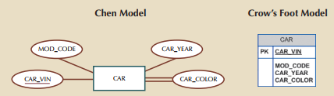
Types of attribute cont.
www.its.ac.id
INSTITUT TEKNOLOGI SEPULUH NOPEMBER, Surabaya - Indonesia

Slide 14
Implementing multivalued attributes
Although ERD can handled multivalued attributes, but we should not implement it in the RDMS
In database table, each column and row represent a single value
www.its.ac.id
INSTITUT TEKNOLOGI SEPULUH NOPEMBER, Surabaya - Indonesia

Slide 15
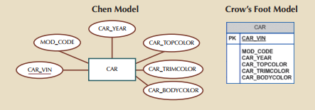
Implementing multivalued attributes
Solution:
Create several new attributes, one for each component of the original multivalued attribute
www.its.ac.id
INSTITUT TEKNOLOGI SEPULUH NOPEMBER, Surabaya - Indonesia

Slide 16

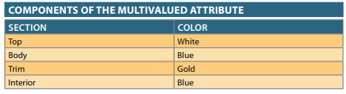
Implementing multivalued attributes
Solution:
Create a new entity of the original multivalued attribute’s component
www.its.ac.id
INSTITUT TEKNOLOGI SEPULUH NOPEMBER, Surabaya - Indonesia

Slide 17
Types of attribute cont.
Derived attribute
An attribute whose valued is calculated from other attribute
Not physically exist
Example: age can be derived from date of birth
www.its.ac.id
INSTITUT TEKNOLOGI SEPULUH NOPEMBER, Surabaya - Indonesia

Slide 18
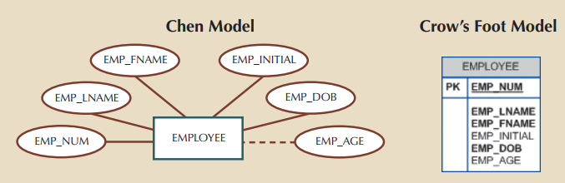
Types of attribute cont.
www.its.ac.id
INSTITUT TEKNOLOGI SEPULUH NOPEMBER, Surabaya - Indonesia

Slide 19
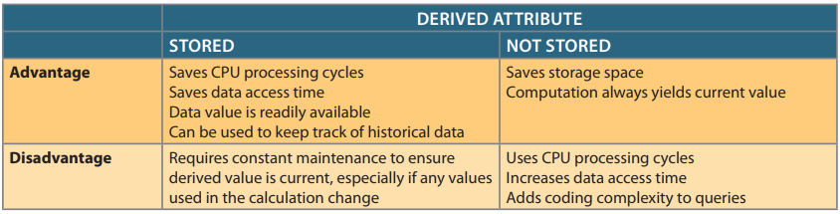
Types of attribute cont.
www.its.ac.id
INSTITUT TEKNOLOGI SEPULUH NOPEMBER, Surabaya - Indonesia

Slide 20
Identifier
One or more attributes that uniquely identify each entity instance
Entity instance represents a row in a database table
Identifier → Primary keys (PK)
Identifier are underlined in ERD
www.its.ac.id
INSTITUT TEKNOLOGI SEPULUH NOPEMBER, Surabaya - Indonesia

Slide 21
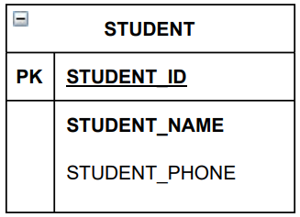
Identifier cont.
www.its.ac.id
INSTITUT TEKNOLOGI SEPULUH NOPEMBER, Surabaya - Indonesia

Slide 22
Composite identifier
Ideally, an entity identifier is composed of only a single attribute
Composite identifier → a PK composed of more than one attribute
www.its.ac.id
INSTITUT TEKNOLOGI SEPULUH NOPEMBER, Surabaya - Indonesia

Slide 23
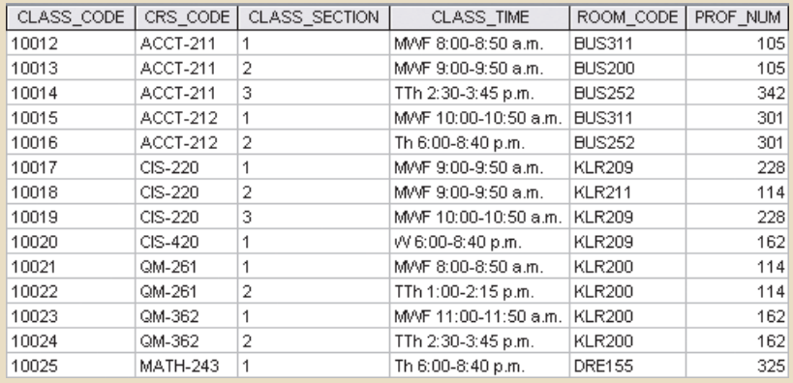
Composite identifier cont.
Composite key if used as identifier
PK
www.its.ac.id
INSTITUT TEKNOLOGI SEPULUH NOPEMBER, Surabaya - Indonesia

Slide 24
Relationships
Relationship is association between entities
Participant is the entities that participate in a relationship
The relationship name is an active or passive verb
Example: A STUDENT takes a CLASS
Relationship between entities always operate in both directions
Types of relationship:
One-to-one
One-to-many
Many-to-many
www.its.ac.id
INSTITUT TEKNOLOGI SEPULUH NOPEMBER, Surabaya - Indonesia

Slide 25
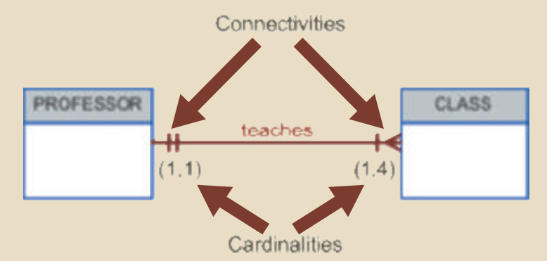
Connectivity and Cardinality
Connectivity is used to describe the relationship classification
Cardinality express the minimum and maximum number of entity occurrences associated with one occurrence of the related entity
In ERD, cardinality using (x,y) format
x → minimum number of associated entities
Y → maximum number of associated entities
www.its.ac.id
INSTITUT TEKNOLOGI SEPULUH NOPEMBER, Surabaya - Indonesia

Slide 26
Connectivity and Cardinality
Connectivity is used to describe the relationship classification
Cardinality express the minimum and maximum number of entity occurrences associated with one occurrence of the related entity
In ERD, cardinality using (x,y) format
x → minimum number of associated entities
Y → maximum number of associated entities
www.its.ac.id
INSTITUT TEKNOLOGI SEPULUH NOPEMBER, Surabaya - Indonesia

Slide 27
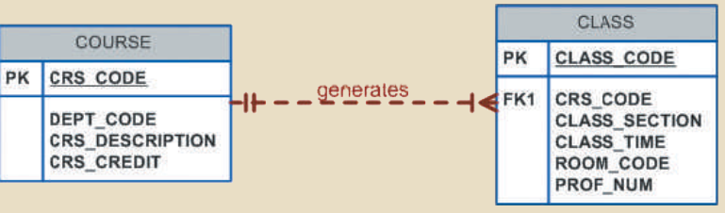
Relationship strength
Weak relationship
Also known as a non-identifying relationship
Exist if the PK of the related entity does not contain a PK component of the parent entity
Example: weak relationship between COURSE and CLASS
PK of COURSE only a FK in the CLASS
www.its.ac.id
INSTITUT TEKNOLOGI SEPULUH NOPEMBER, Surabaya - Indonesia

Slide 28
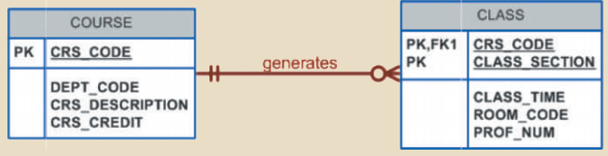
Relationship strength
Strong relationship
Exist when PK of the related entity contains a PK component of the parent entity
Example: strong relationship between COURSE and CLASS
PK in CLASS inherit a PK from COURSE
www.its.ac.id
INSTITUT TEKNOLOGI SEPULUH NOPEMBER, Surabaya - Indonesia

Slide 29
Relationship degree
Indicates the number of entities associated with a relationship
Unary relationship
Association is maintained within a single entity
Binary relationship
Two entities are associated
Ternary relationship
Three entities are associated
www.its.ac.id
INSTITUT TEKNOLOGI SEPULUH NOPEMBER, Surabaya - Indonesia

Slide 30

Unary relationship
An employee manage another employee
www.its.ac.id
INSTITUT TEKNOLOGI SEPULUH NOPEMBER, Surabaya - Indonesia

Slide 31
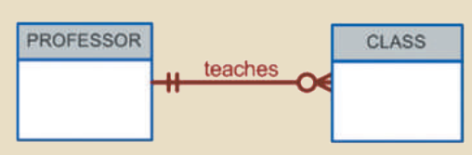
Binary relationship
A professor teach class
www.its.ac.id
INSTITUT TEKNOLOGI SEPULUH NOPEMBER, Surabaya - Indonesia

Slide 32
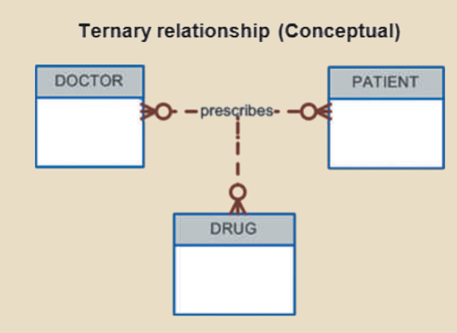
Ternary relationship
www.its.ac.id
INSTITUT TEKNOLOGI SEPULUH NOPEMBER, Surabaya - Indonesia

Slide 33
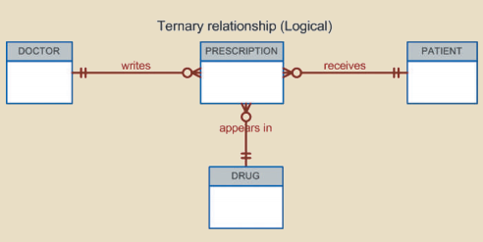
Ternary relationship
www.its.ac.id
INSTITUT TEKNOLOGI SEPULUH NOPEMBER, Surabaya - Indonesia

Slide 34
Create ERD
Entity identification
Relationship identification
Cardinality identification
Attribute identification
ERD
www.its.ac.id
INSTITUT TEKNOLOGI SEPULUH NOPEMBER, Surabaya - Indonesia

Slide 35
Example
Business rules:
Each school is administered by a dean who is a professor
Each professor can be the dean of only one school
A professor is not required to be the dean of any school
Each school comprises several departments
The smallest number of departments operated by a school is one, and the largest number of departments is indeterminate (N)
Each department belongs to only a single school
www.its.ac.id
INSTITUT TEKNOLOGI SEPULUH NOPEMBER, Surabaya - Indonesia

Slide 36
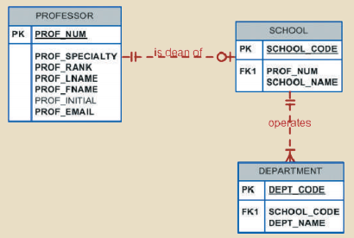
www.its.ac.id
INSTITUT TEKNOLOGI SEPULUH NOPEMBER, Surabaya - Indonesia

Slide 37
Exercise
In a group, create a Crow’s foot ERD based on the following business rules
A department employs many employees, but each employee is employed by only one department.
A division operates many departments, but each department is operated by only one division.
An employee may be assigned many projects, and a project may have many employees assigned to it.
A project must have at least one employee assigned to it.
One of the employees manages each department, and each department is managed by only one employee.
One of the employees runs each division, and each division is run by only one employee.
www.its.ac.id
INSTITUT TEKNOLOGI SEPULUH NOPEMBER, Surabaya - Indonesia

Slide 38
Thank you

